Slide 1

CMR COLLEGE OF ENGINEERING & TECHNOLOGY
Kandlakoya, Medchal, Hyderabad - 501401
Department of Computer Science and Engineering
Bharat Citizen Portal
Name of the student & Roll No.
K. SUSHMITHA -(20H51A0539)
E. PRIYANKA -(20H51A0589)
RAJNISH YADAV-(20H51A05P8)
Under esteemed guidance of
Guide Name : Ch. Raja Kishore Babu
Associate Professor

Slide 2
Outline
Abstract
Introduction
Literature survey
Existing system
- Problems in the existing system
Research Objectives
Problem Definition
Research work
- Proposed system architecture
- Methods
- Comparing the Proposed system with an existing system
Performance Measure
Results
Conclusion
Future Work
References
Notes:
2

Slide 3
Abstract
Notes:
3

Slide 4
ABSTRACT
The proposed system is a web application which enables Citizens of India to avail the various centralized schemes sanctioned by the Government of India.
The applicants explore utilizing features from the Government Sanctioned Schemes and utilized for procuring necessary data for further analysis for the citizens and availing various schemes by given them pointers.
Then the research also includes a thorough evaluation of the applicants’ details and inform them. This system also aims to enhance the effectiveness of finding appropriate schemes for the applicant and helping genuine candidates for getting benefits of Schemes of the Government.
The project is mostly about detecting relevant information and the irrelevance in the applications to avail various resources from the government to the citizens using Big Data Analytics.
The whole project is divided into two main phases, which are analyzing the applications with a suitable set of Machine Learning algorithms and then training machine and Deep Learning methods on derived features to recognize correct and wrong information.
The website is built on interactive frontend web technology and Data Structures for extracting various types of information by executing backend code while dynamic analysis extracts feature during code execution or emulation on the data in database.

Slide 5
INTRODUCTION
Notes:
5

Slide 6
Introduction
India is still struggling with the growing housing ,pension and other necessity problems , especially for the citizens of India.
There are many issues regarding the acceptance of home loans, education loans , pensions that are acting like subsidies.
The users have to spend some time in knowing the interfaces of different applications or have to spend some amount to apply from the help some professionals. They usually don't get any material to guide them through the whole process.
By taking all these government schemes as reference we are making an application where all the schemes can be accessed from our application Bharath citizen portal.
The main aim of Bharath citizen portal is Providing a pucca house, pensions, provident funding etc. with basic amenities to all houseless households.
Government schemes such as education loans, home loans, provident funds, and pension plans play a vital role in promoting financial stability and social welfare in india.
The portal aims to provide financial security and stability to workers in the unorganized sector, Economically Weaker Sections or Middle-Income Groups.
Notes:
6

Slide 7
Literature Review

Slide 8
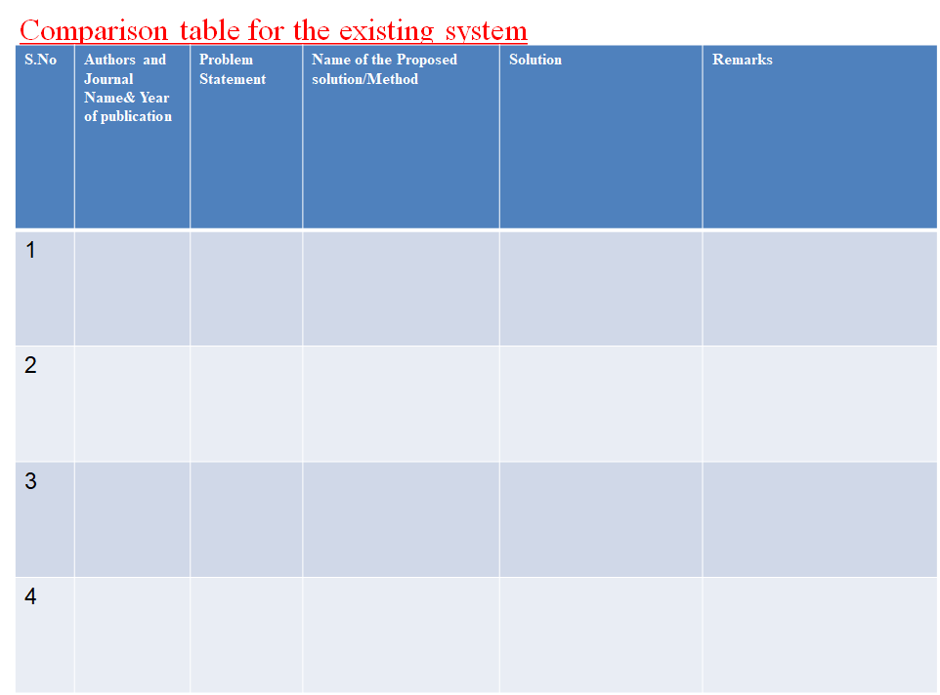
C. A, S. V. K, S. R. B and M. Ch,
Interdisciplinary Approaches in Technology and Management for Social Innovation (IATMSI)
2022
The Pradhan Mantri Awas Yojana (PMAY) was established with the goal of providing affordable homes to the poorer sectors of society.
Representation of Status of Buildings under PMAY Scheme
We come up with the idea that can be implemented on national scale. It is mostly based on Machine Learning techniques (Data processing) and representation of housing data on map with the help of GIS coordinates of the building.
It might allow for frequent updates and cost-effectiveness analysis That might be useful in a variety of situations. For this study, we have taken the areas where the PMAY scheme is implemented.
D. Chenge, Z. Xiao, H. Jingxi, W. Sitong and T. Pei
International Conference on Intelligent Computing and Signal Processing (ICSP)
In the conventional gesture recognition algorithm such as Support Vector Machine (SVM) and Dynamic Time Warping (DTW), the calculation time and accuracy.
Gesture Classification Algorithm Based on SVDD-EPF
This method mainly uses effective interception data to replenish the length of different gesture data to the same, and generates a continuous and smooth function. On this basis, the SVDD algorithm acts on the extreme points of the function.
The results show that the gesture recognition rate of the SVDD-EPF algorithm is higher than that of the traditional SVM algorithm, that is, a better recognition state can be achieved. If it is applied to a mobile phone unlock, it is expected to become a new generation of unlock mode.
D. S. Harsha, S. Praneetha, V. Swetha, P. Dinesh and K. S. Vani
Global Conference for Advancement in Technology (GCAT)
During More than 10.5 million individuals in India live in kutcha houses and are described by helpless everyday environments, the consistent convergence
Evaluation of Support to Beneficiaries Under PMAY using Clustering Techniques
To improve this Government of India has as of late dispatched a moderate lodging plan, Pradhan Mantri Awas Yojana – Housing for All (Urban) Mission” for metropolitan territory is being executed during 2015-2022.
The entire process aims at understanding all these activities by clustering (Machine Learning technique) of housing data using GIS coordinates and mapping these clusters to disclose the stages of houses at corresponding location/area.
W. -E. Chen, C. -C. Chiu, Y. -B. Chang and Y. -W. Chiang
International Wireless Communications and Mobile Computing Conference (IWCMC)
Recently, the key issues of Machine-to-Machine (M2M) communications also known as Machine Type Communications (MTC) are widely discussed.
An Enhanced Port Forwarding (EPF) solution for NAT traversal in 3GPP Machine Type Communications
However, the private IPv4 addresses are used for current configurations. Thus, the Network Address Translation (NAT) traversal problem should be resolved for MTC in 3GPP architecture. In this paper, we introduce the architectures and call flows of three NAT traversal solutions defined in 3GPP 23.888.
Then we propose an Enhanced Port Forwarding (EPF) solution to minimize the impacts on the MTC device and 3GPP core network. Finally, we analyze and compare the proposed EPF solution with the existing solutions.

Slide 9
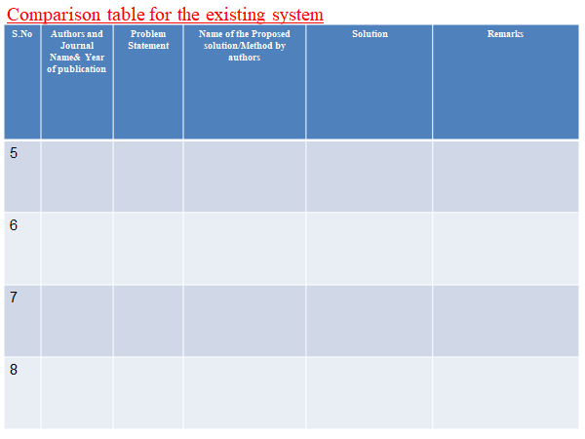
Y. Wang and J. Yin
IEEE Congress on Evolutionary Computation (CEC)
Research on synthetic aperture radar (SAR) scene matching in the aircraft end-guidance has a significant value for both research and real-world application.
Intelligent search optimized edge potential function (EPF) approach to synthetic aperture radar (SAR) scene matching
The conventional scene matching methods, however, suffer many disadvantages such as heavy computation burden and low convergence rate so that these methods cannot meet the requirement of end-guidance system in terms of fast and real-time data processing.
It might allow for frequent updates and cost-effectiveness analysis That might be useful in a variety of situations. For this study, we have taken the areas where the PMAY scheme is implemented.
S. Kim, H. Oh and C. Kim
International Conference on Big Data and Smart Computing (BIGCOMP)
CISCO VNI predicted an average annual growth rate of 69.1% for mobile video traffic between 2013 and 2018 and accordingly much academic research related to initiated.
ePF-DASH: Energy-efficient prefetching based dynamic adaptive streaming over HTTP
In video streaming, Adaptive Bitrate (ABR) is a streaming technique in which a source video is stored on a server at variable encoding rates and each streaming user requests the most appropriate video encoding rate from the server considering their channel capacity or signal power.
CISCO VNI predicted an average annual growth rate of 69.1% for mobile video traffic between 2013 and 2018 and accordingly much academic research related to video streaming has been initiated.
J. Cong, C. Li, F. Liu and D. Chu
International Conference on Service Science (ICSS)
How to recommend appropriate pension services to the elderly is an active research problem in health care fields in recent years.
EPF: An Elderly Personalization Features Based Collaborative Filtering Algorithm for Pension Service
In the algorithm, personalized requirements form the elderly customers can be obtained by the classification of pension services. Based on classification results, the customer personalization features model can be built, in which customers are divided into several groups
Finally the CF algorithm can be employed to detect appropriate pension services to the elderly. The experiments show that the algorithm can improve the accuracy of predicted ratings, as well as the satisfaction of elderly customers.
O. Putyatina
International Conference - The Experience of Designing and Applications of CAD Systems in Microelectronics
This paper discusses the problems of Ukrainian new pension system, non-state pension funds in particular.
Designing an Information System for Pension Fund Management.
The paper is concerned with development of mathematical methods and models that would form a base of management information systems.
The new pension system has been lawfully ratified only three years ago and is still developing, that is why this paper is very important.

Slide 10
Existing systems

Slide 11
Problems in existing systems :
The problems in existing system are
The implementation of the existing solutions is that they are in different websites and the status of their application is not updated.
The applicants have to personally check their application status and the once who can't have to wait for the final announcement if any for the applications.
It makes difficult for a single applicant to manage all his/her application in different websites and crossing over to them and have to get familiar with their method of checking status.
The users have to spend some time in knowing the interfaces of different applications or have to spend some amount to apply from the help some professionals.
They usually don't get any material to guide them through the whole process.

Slide 12
Research Objective
Notes:
12

Slide 13
Research objective
Providing citizens the ease of getting their remaining income through the home.
Helping citizens to avail substantial subsidies for home loans.
Guiding pensioners to afford the benefits they deserve.
Navigating students to accommodate good education with conventional education loan

Slide 14
Problem Definition
Notes:
14

Slide 15
Problem Definition
The proposed system aims to help citizens seek the various schemes provided by the government.
Various schemes work on devoting finance, housing, pensions, etc.
The system is a guide to citizens within the loop and mess of the schemes and facilities that are sanctioned by the government.
The citizens mostly go along the way they are told to without ever knowing that they are either getting close to availing or getting rejected.
The system covers up such loopholes in the monitoring system of the government and helps citizens.
These benefits are for the citizens but the lack of awareness of schemes and the ways to avail them renders such ideas useless and the system would reduce such inefficiencies to the utmost extent possible.

Slide 16
Research work
Notes:
16

Slide 17
Proposed System Architecture

Slide 18
Proposed Methodology
The Bharat Citizen portal is a technological solution aimed at bridging the gap between citizens and the various government schemes.
It acts as a centralized platform, offering citizens easy access to a plethora of central government initiatives related to finance, housing, and other crucial areas.
One of the key technical features of the portal is its user-friendly interface.
Security is a paramount concern, and the Bharat Citizen Portal incorporates robust measures to safeguard user data.
It addresses the common issue of citizens being unaware of available programs or not understanding the application process.
Through a well-organized and easily navigable interface, citizens can explore the various schemes, understand eligibility criteria, and initiate the application process seamlessly.
The portal acts as a corrective tool, identifying loopholes in the government's monitoring system.
This enables better oversight, reducing the chances of citizens being misguided or overlooked in the process.
This methodology also incorporates the training algorithms like K-Means, Bayes, Linear Regression along with the development framework to evaluate the applicants and make sure that the application is legit.

Slide 19
Comparison of proposed systems in existing system
The existing system lacks the uniqueness and integration of schemes that the proposed system is providing.
The usage of interactive user-interface helps proposed system overcome the necessity of simple and easy to use user-interface that is missing in the previous system.
The Unique ID generated after thorough evaluation of the application using ML algorithms helps identify the applicant and reduces the amount of frauds efficiently.
The chatbot is again a special facility provided by the proposed system which didn’t exist in the previous system to help citizens in the process of their application and solving the problems incur during the whole process.
The integration of schemes which were supposedly to work in their own individuality has reduce the burden and provided a hassle-free experience in the management of the applications.
The framework allows us to incorporate various technologies like database, front-end designs, back-end development and few data structures and algorithms to store and manage data of both user and admin so that they can carry out their tasks of applying and validating respectively.

Slide 20
Performance measure

Slide 21
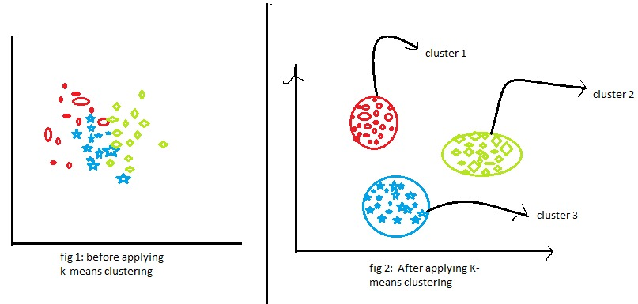
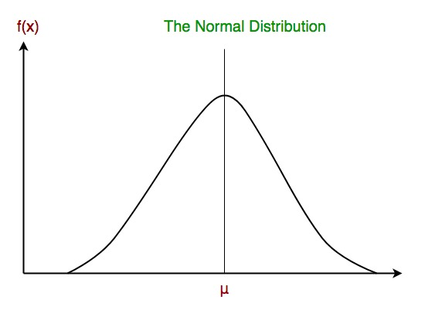
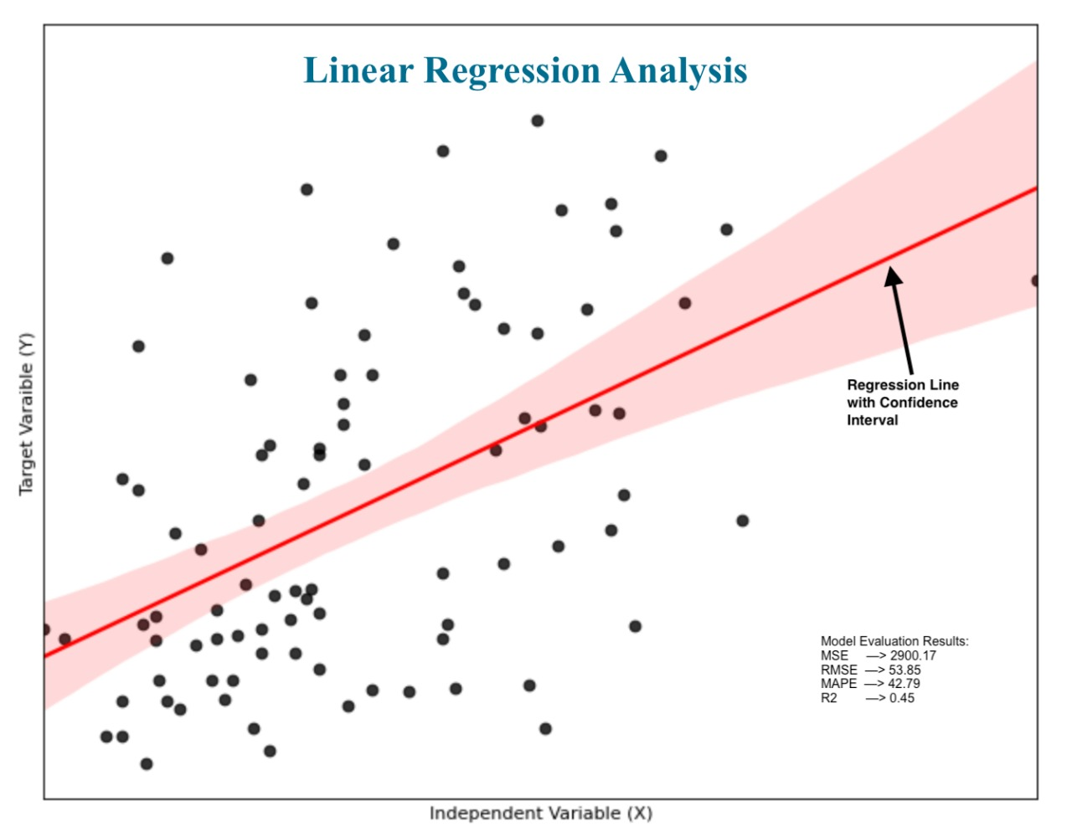
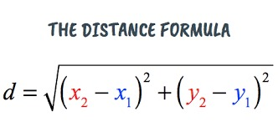
Performance measure
Linear Regression :
(True Positives + True Negatives)
Accuracy =
(True Positives + True Negatives + False Positives + False Negatives)
Naïve Bayes :
P(validate | accept) P(accept)
P(accept | validate) =
P(validate | accept) P(accept) + P(validate | reject) P(reject)
K-Means :
Silhouette score = Euclidean distance function to find distance between the points

Slide 22
Result

Slide 23
Result
It has contributed to the government's goal of ensuring housing for all. The project successfully developed a web application featuring four prominent Indian central government schemes: PMAY, VLY, EPF, and APY. We integrated a user-friendly chatbot to address applicant queries, streamlining the application process. Applicants are guided through a form submission, receiving a unique ID upon approval and timely notifications in case of rejection. This system enhances accessibility and efficiency in accessing government schemes, empowering citizens with seamless application experiences.

Slide 24
CONCLUSION

Slide 25
Conclusion
The Bharath Citizen Portal has emerged as a transformative platform that has streamlined access to key government schemes, including Pradhan Mantri Awas Yojana (PMAY), Atal Pension Yojana (APY), Central Sector Interest Subsidy Scheme, and Employee Provident Funds (EPF). It has had a profound impact on the socio-economic landscape of India, addressing critical areas of housing, retirement security, higher education, and financially.
The web application represents a significant step towards enhancing accessibility to Indian central government schemes. By incorporating user-friendly features such as a chatbot for applicant queries and a streamlined application process, we have simplified the journey for citizens seeking to benefit from PMAY, VLY, EPF, and APY. With timely notifications and clear feedback mechanisms, we ensure transparency and efficiency in the application process, ultimately contributing to the government's goal of inclusive governance and citizen empowerment. Our project stands as a testament to the potential of technology to bridge gaps and facilitate access to essential services for all.

Slide 26
Future work

Slide 27
Future work
The future development of the integrated project combining the Pradhan Mantri Awas Yojana (PMAY), Employees' Provident Fund (EPF), Atal Pension Yojana (APY), and Vidya Laxmi Yojana (VLY) presents a significant opportunity to expand its reach and maximize its impact on societal well-being.
Efforts to enhance integration and coordination among different stakeholders are essential for the seamless delivery of project services. Strengthening collaboration between government departments, financial institutions, and implementing agencies will optimize resource allocation and improve the efficiency of service delivery to beneficiaries.
Moreover, leveraging technology solutions such as digital platforms and mobile applications can streamline processes, enhance transparency, and facilitate greater accessibility, particularly in remote or rural areas where traditional infrastructure may be lacking.

Slide 28
References

Slide 29
References
A_Study_on_Public_Perception_on_Pradhan_Mantri_Awas_Yojana
https://ieeexplore.ieee.org/document/9934357/
https://financialservices.gov.in/pension-reforms-divisions/Atal-Pension-Yojana
https://www.epfindia.gov.in/site_en/index.php
https://ieeexplore.ieee.org/document/4297597/
https://pmaymis.gov.in/
https://ieeexplore.ieee.org/document/9587732

